Slide 1
PRG2: Software Installation Requirements
Windows 10 (Version 1703 or higher)
Visual Studio Community 2019
Make sure your notebook is installed with Windows 10. Please consult NP helpdesk for an upgrade.
*** Install Windows 10 before lessons starts.
** Bootcamp for Mac OS is preferred.

Slide 2
Windows 10
Home, Professional, Enterprise and Education
and
Version number

Slide 3
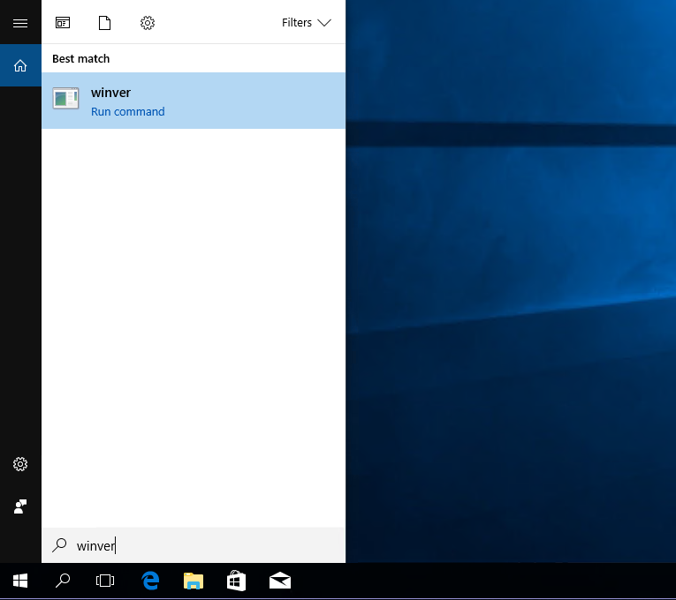
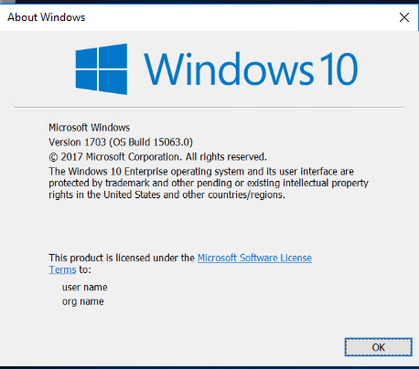
Windows 10 Version
winver

Slide 4
Visual Studio 2019
Community Version
30 minutes installation

Slide 5
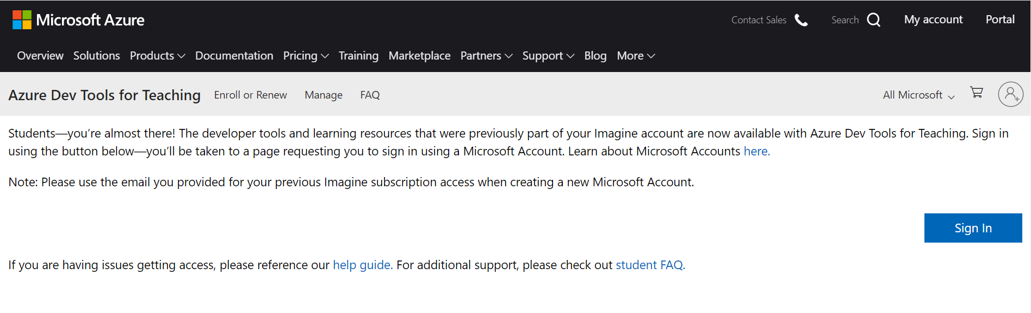
Visual Studio Community 2019
Go to https://azureforeducation.microsoft.com/devtools and click on Sign In

Slide 6
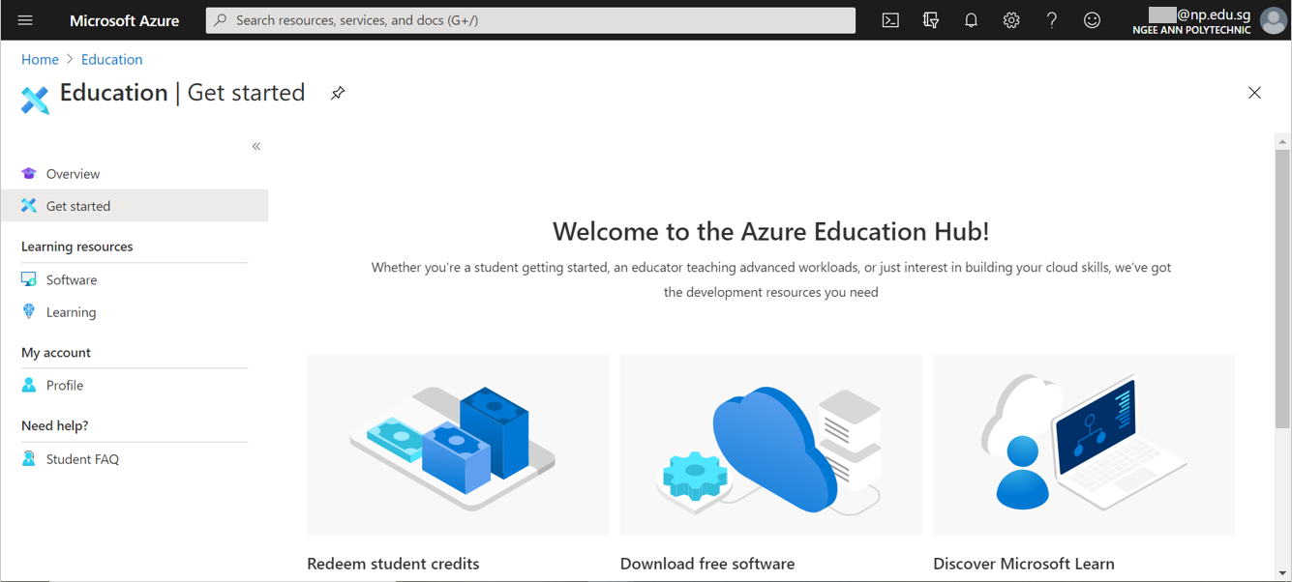
Visual Studio Community 2019
Sign In with your school email using your NPNET password. Click Next and wait for your account to get verified by the site. Once verified, you will see the following page.

Slide 7
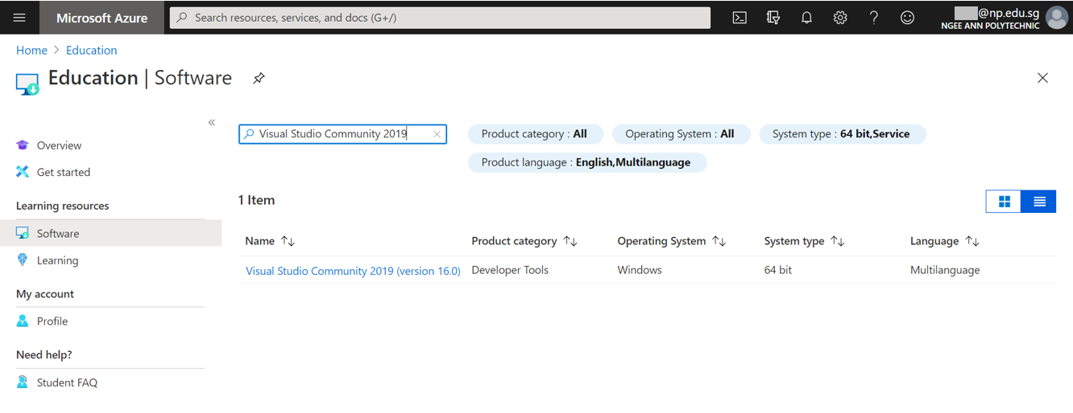
Visual Studio Community 2019
Click Software and type Visual Studio Community 2019 at the search bar.
Click on the Visual Studio Community 2019 and click Download

Slide 8
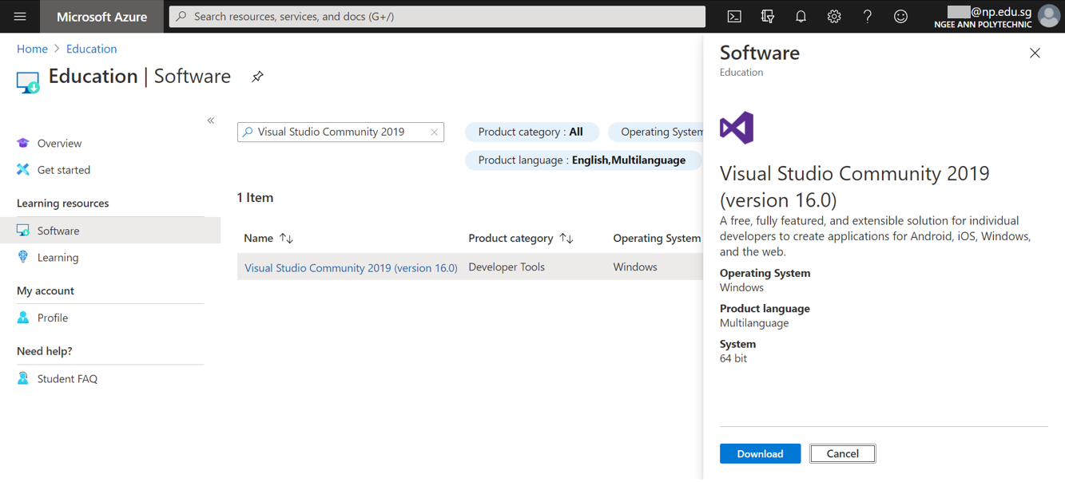
Visual Studio Community 2019
Click on the Visual Studio Community 2019 and click Download

Slide 9
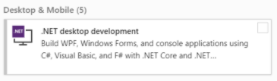
Visual Studio Community 2019
Installer file will pop out and wait for it to download finish.
Right click on the installer file and select Run as administrator.
Click Continue and wait for it to load the installation.
Select .NET desktop development under Workloads and click Install.
Wait for the installation to finish.
Click Launch. Restart laptop once prompted to reboot.
Launch Visual Studio Community, sign in with your NP account.

